Slide 1
Bike Sharing Company Visualizations
File created on: 7/10/2025 8:00:50 AM
Created by Rikki Montero

Slide 2
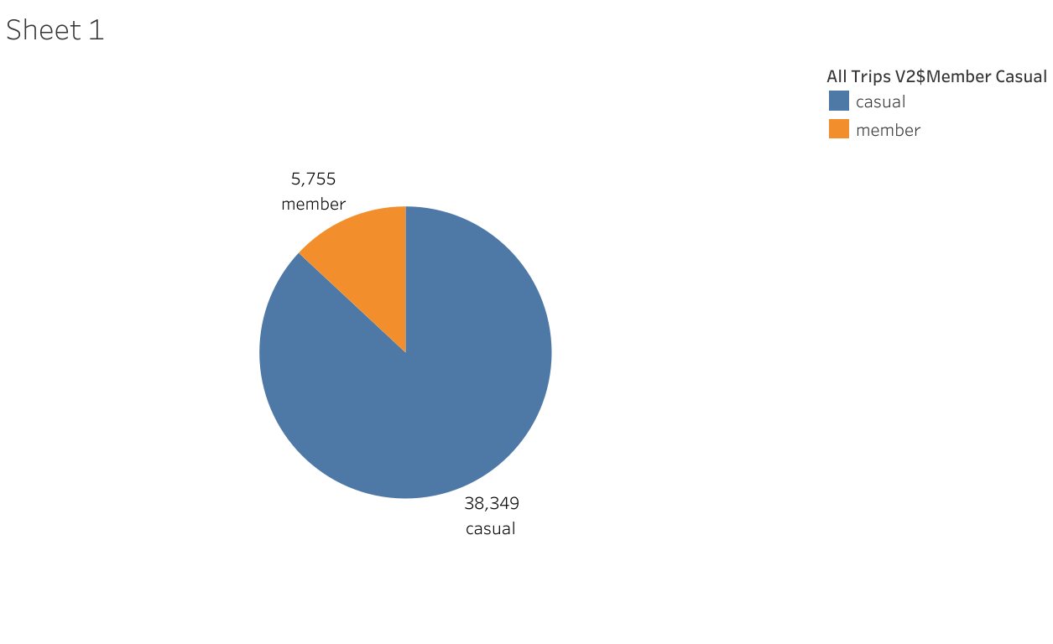

Slide 3
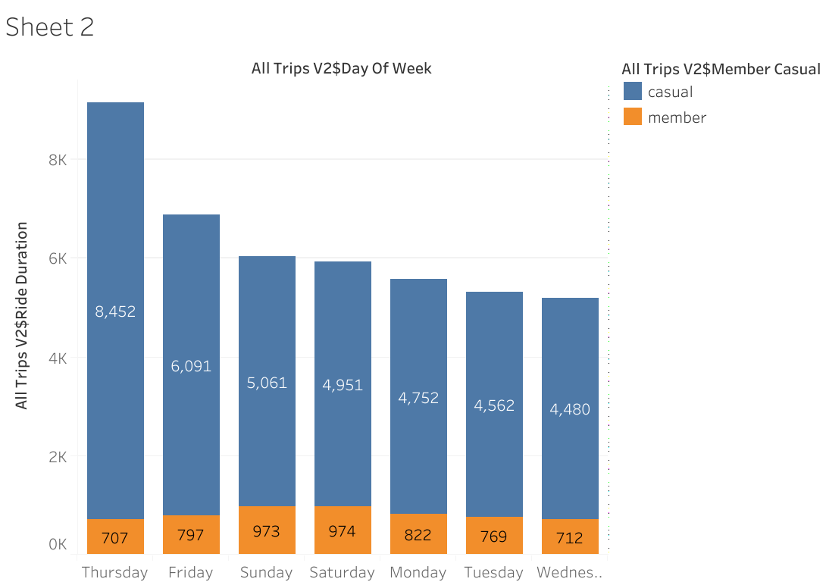

Slide 4
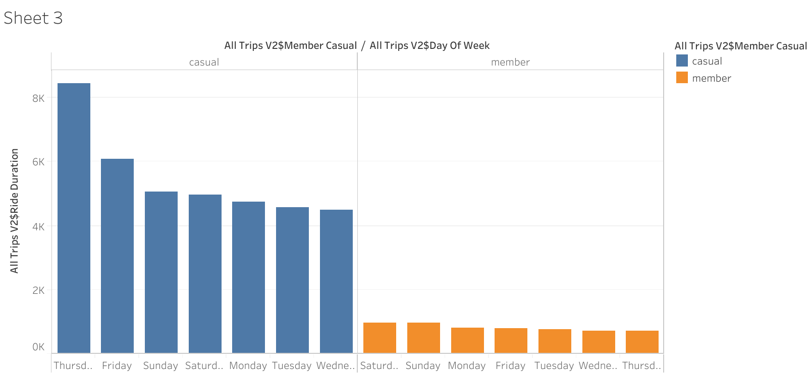

Slide 5
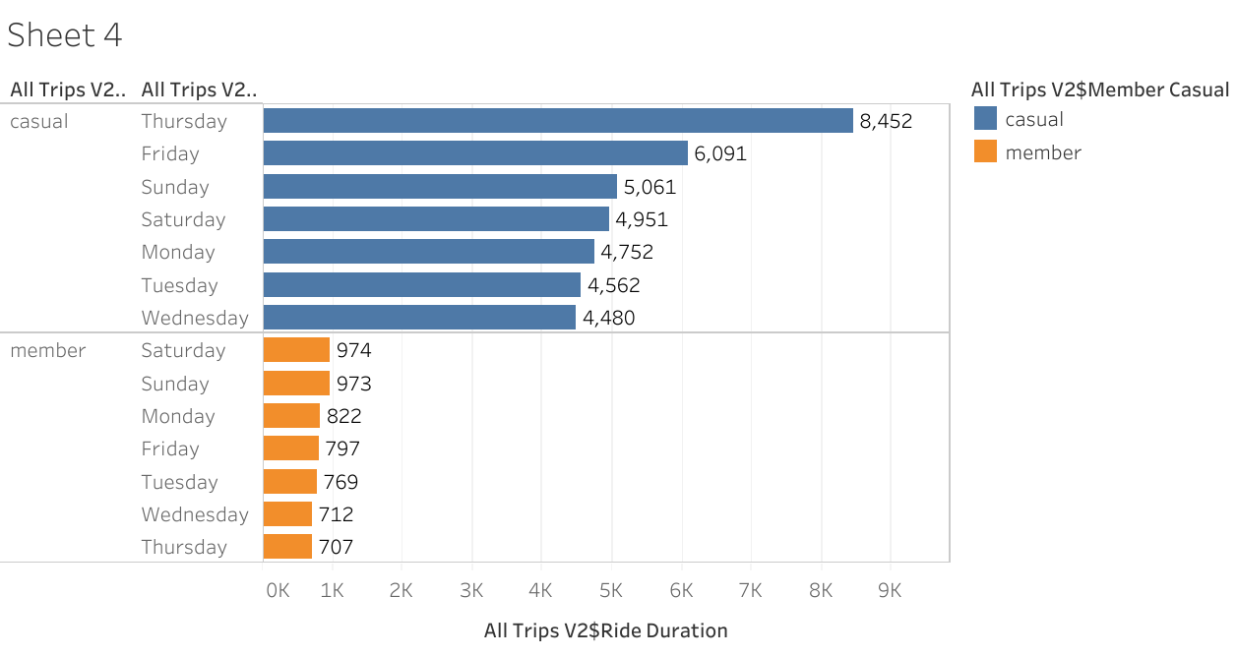

Slide 6
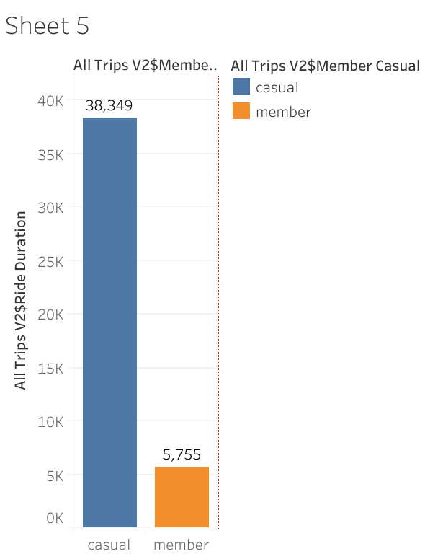

Slide 7
